Slide 1
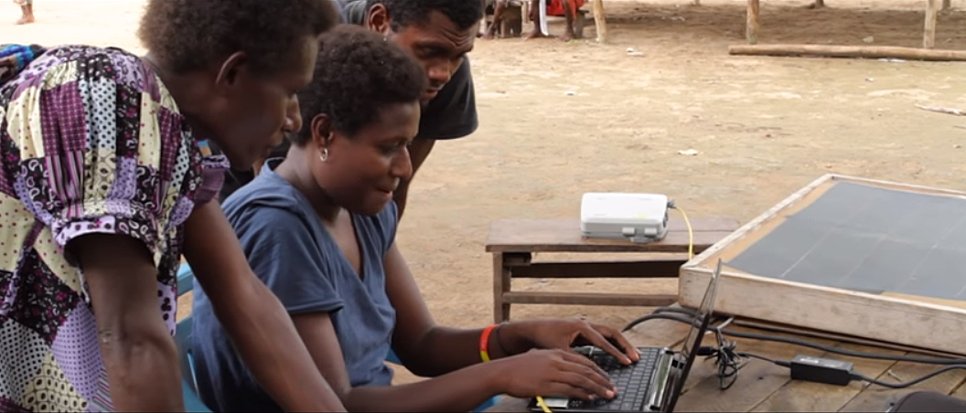
Refinement and Revision Resources

Slide 2
After the 8 Steps of MAST
Refinement: a process that includes other Christians from the language community

Slide 3
?
Generate Scripture interest
Insight: how community understands translation
Why include others?
Build relationships and ownership

Slide 4
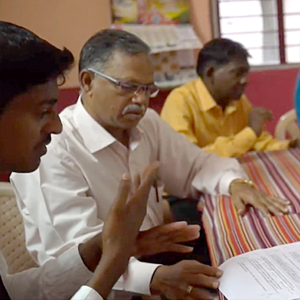
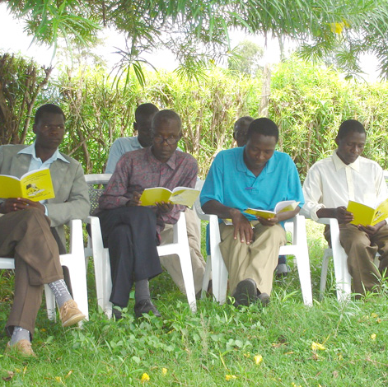
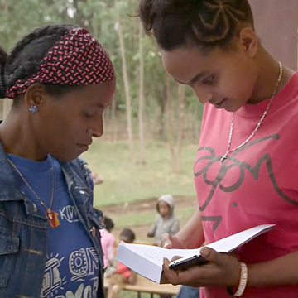
How to Include Others
Bible study/small group activity
Sunday school class
One-on-one in homes

Slide 5
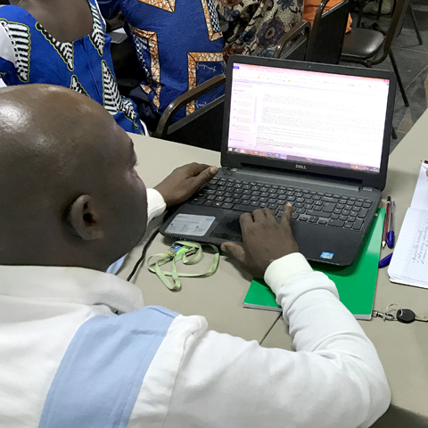
Refinement Resources
Translation Topics
Translation Manual
Reviewer’s Guide
Greek Words for Translators and Bible Commentary

Slide 6

Bibleineverylanguage.org

Slide 7


